Slide 1

Presentation on Micro Credit Defaulter predictions
Submitted by- Sankalp Mahapatra
Internship 29

Slide 2
TABLE OF CONTENTS
INTRODUCTION
Business Problem Framing
Business goal
Motivation for the Problem undertaken
Exploratory Data Analysis (EDA)
Data Visualization
Model/s Development and Evaluation
Hyperparameter tuning using GridSearchCV
Conclusion

Slide 3
INTRODUCTION
Credit defaulter risk is one of the most important risks to be managed by a financial institution. Without loan repayment there is no profit, hence the problem of credit defaulter risk management is relevant to all financial institutions involved in lending to individuals and legal entries. This is even more true with microcredit organizations who have only one product-loans.
Banks have a diverse portfolio so the risk is somewhat mitigated but credit risk is still the most important to manage. Credit risk is economic loss that emanates from the failure of a counterparty to fulfil its contractual obligations or from the increased risk of default during the term of transaction.

Slide 4
Business Problem Framing
A Microfinance Institution (MFI) is an organization that offers financial services to low-income populations. MFS becomes very useful when targeting especially the unbanked poor families living in remote areas with not much sources of income. The Microfinance services (MFS) provided by MFI are Group Loans, Agricultural Loans, Individual Business Loans and so on.
Many microfinance institutions (MFI), experts and donors are supporting the idea of using mobile financial services (MFS) which they feel are more convenient and efficient, and cost saving, than the traditional high-touch model used since long for the purpose of delivering microfinance services. Though, the MFI industry is primarily focusing on low-income families and are very useful in such areas, the implementation of MFS has been uneven with both significant challenges and successes.

Slide 5
Business goal
This case study aims to develop a basic understanding of credit loan defaulter risk analytics in banking and financial services and understand how data is used to minimise the risk of losing money while lending to customers. The loan providing companies find it hard to give loans to the people due to their insufficient or non-existent credit history. Because of that, some consumers use it as their advantage by becoming a defaulter.
A client in Telecom Industry is collaborating with an MFI (Microfinance Institution) to provide micro-credit on mobile balances to be paid back in 5 days. The Consumer is believed to be defaulter if he deviates from the path of paying back the loaned amount within the time duration of 5 days. In order to improve the selection of customers for the credit, the client wants some predictions that could help them in further investment and improvement in selection of customers.
In this project we need to build a model which can be used to predict in terms of a probability for each loan transaction, whether the customer will be paying back the loaned amount within 5 days of insurance of loan. In this case, Label ‘1’ indicates that the loan has been paid i.e., “non-defaulter”, while, Label ‘0’ indicates that the loan has not been paid i.e., “defaulter”.

Slide 6
Conceptual Background of the Domain Problem
Microfinance is a banking service provided to unemployed or low-income individuals or groups who otherwise would have no other access to financial services. Indonesia is renowned for its large-scale microfinance sector, with a range of commercial banks. Some rural communities in Indonesia have no choice but to seek out loans from unregulated moneylenders. Micro lenders, particularly those operating under Indonesian banks, as well as social
enterprise start-ups, are also targeting these communities through their high mobile penetration rates and are developing the right digital platforms to reach out to them.

Slide 7
Generally, Credit Scores plays a vital role for loan approvals, and is very important in today’s financial analysis for an individual, Most of the loan lending vendors rely heavily on it, so in our case users has 5 days’ time to pay back the loan or else they are listed as defaulters which will impact the loan the credit score heavily, so there are few thing to lookout in this dataset as users who are taking extensive loans, user who have most frequent recharges in their main account have a good chance of 100% payback rate, and user who never recharged their main account for them loan should have never been approved as there is high chance for single user or default user taking multiple connections in name or documents of the family members.

Slide 8
Motivation for the Problem Undertaken
The main objective of this study is to investigate which method from a chosen set of machine learning techniques performs the best default prediction. This project was highly motivated project as it includes the real time problem for Microfinance Institution (MFI), and to the poor families in remote areas with low income, and it is related to financial sectors, as I believe that with growing technologies and Idea can make a difference, there are so much in the financial market to explore and analyse and with Data Science the financial world becomes more interesting.

Slide 9
The project gives an insight to identify major factors that lead to credit risk portfolio in microfinance banks and provide recommendations aimed at mitigating credit risks in microfinance banks. With the help of independent variables available in the dataset we need to model the micro credit defaulters’ level in the micro finance institution. This model will help the management to understand how the users considered as defaulter or non-defaulter based on the attributes available. The model will be a good way for the management to understand whether the customer will be paying back the loaned amount within 5 days of issuing loan. We are provided with sample data, in order to improve the selection of customers for the credit, the client wants some predictions that could help them in further investment and improvement in selection of customers.

Slide 10
Exploratory Data Analysis (EDA)
These are the different steps I have undertaken to perform the Exploratory Data Analysis:
Importing necessary libraries and loading dataset as a data frame.
Used pandas to set display maximum columns ensuring not to find any truncated information.
Checked some statistical information like shape, number of unique values present, info, finding zero values etc.
Checked for null values and did not find any null values.
Dropped some unwanted columns like Unnamed:0, pcircle, msisdn as they are of no use for prediction.
Dealt with zero values by verifying the percentage of zero values in each column and decided to discard the columns having more than 90% of zero values.

Slide 11
Converted time variable “pdate” from object into datetime and extracted Day, Month and Year for better understanding. Checked value counts for each and dropped Year column as it contains unique value throughout the dataset.
Checked unique values and value counts of target variable.
Converted the data having values other than 6, 12 & 0 into 0 in the column maxamnt_loans30. As it is specified in the problem statement that we should have only 0, 6 & 12 values. Also, discarded some rows in the column amnt_loans90 as it gives the sum of loans taken by the user in 90 days
While checking the statistical summary of the dataset, I found some columns having negative values which were invalid and unrealistic so decided to convert negative values into positive using absolute command.
Visualized each feature using seaborn and matplotlib libraries by plotting several categorical and numerical plots like pie plot, count plot, bar plot, distribution plot, box plots etc.

Slide 12
Identified outliers using box plots and I tried to remove them using both IQR method and got huge data loss of around 62% respectively, so removed outliers using percentile method by setting data loss to 2%.
Checked for skewness and removed skewness in numerical columns using power transformation method (yeo-johnson).
Used Pearson’s correlation coefficient to check the correlation between label and features. With the help of heatmap, correlation bar graph was able to understand the Feature vs Label relativity and insights on multicollinearity amongst the feature columns.
Separate feature and label data and feature scaling is performed using MinMaxScalar method to avoid any kind of data biasness.
Since the dataset was imbalanced. Label ‘1’ had approximately 87.5% records, while, label ‘0’ had approximately 12.5% records. So, performed Oversampling method using SMOTE to balance the data.

Slide 13
Checked for the best random state to be used on our Classification Machine Learning model pertaining to the feature importance details.
Finally created classification model along with evaluation metrics.

Slide 14
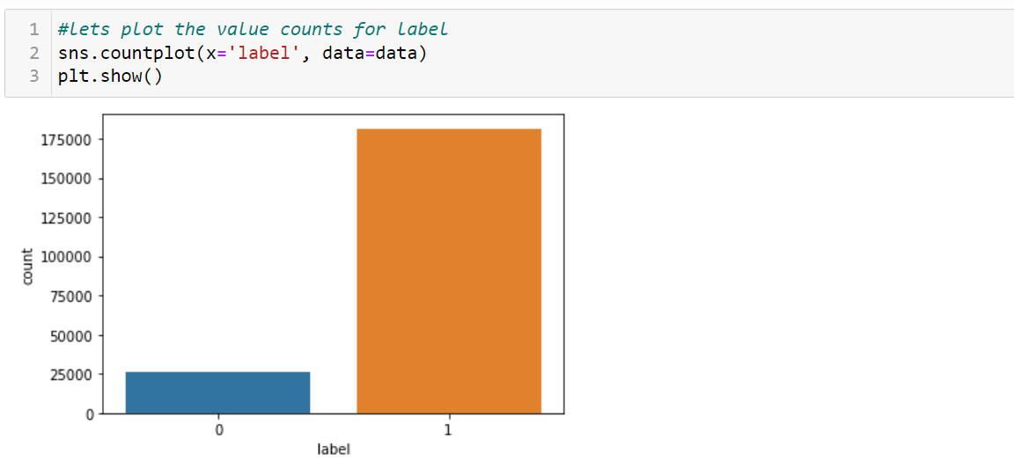
Data Visualization
From the above we can see that the data set is highly imbalanced, so applied SMOTET method to balance the dataset.

Slide 15
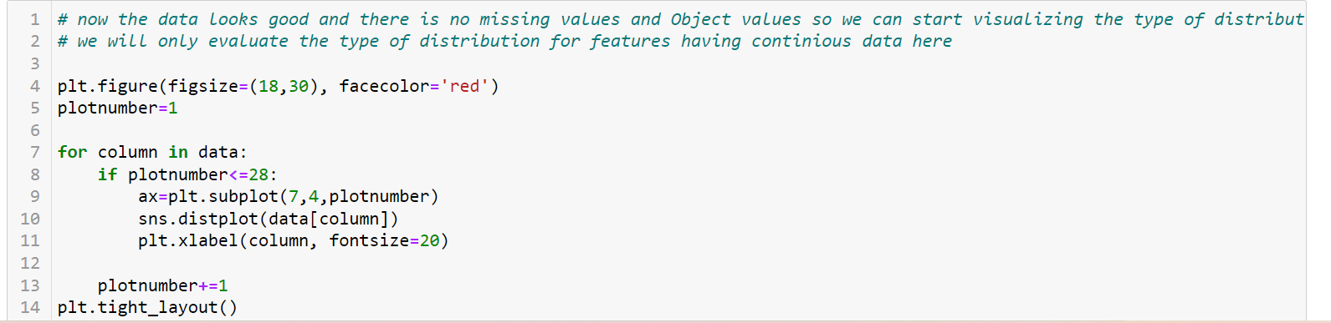
Using distplots to identify the presence of skewness in the dataset

Slide 16
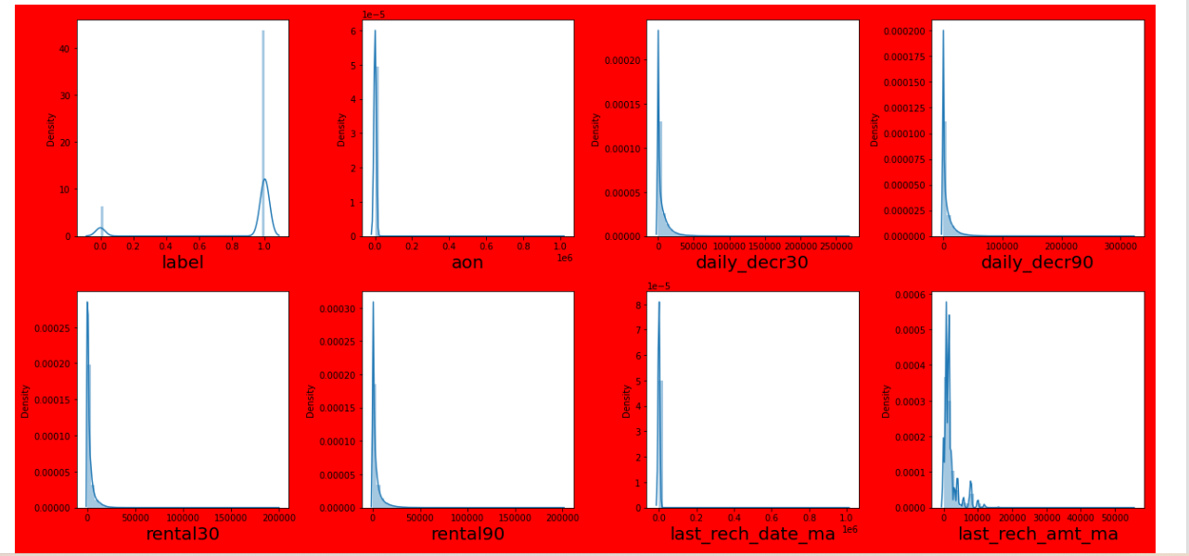

Slide 17
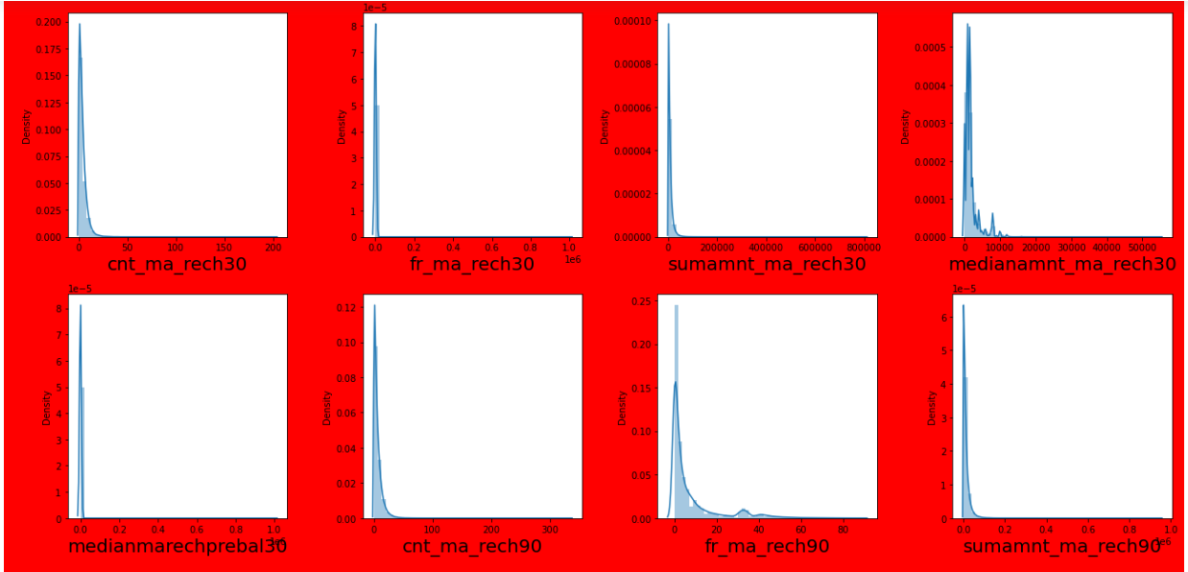

Slide 18
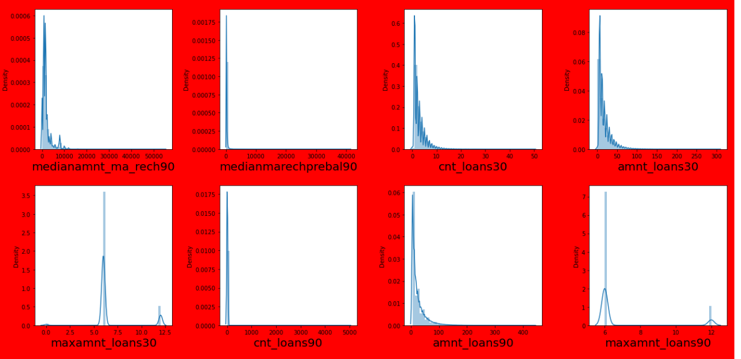

Slide 19
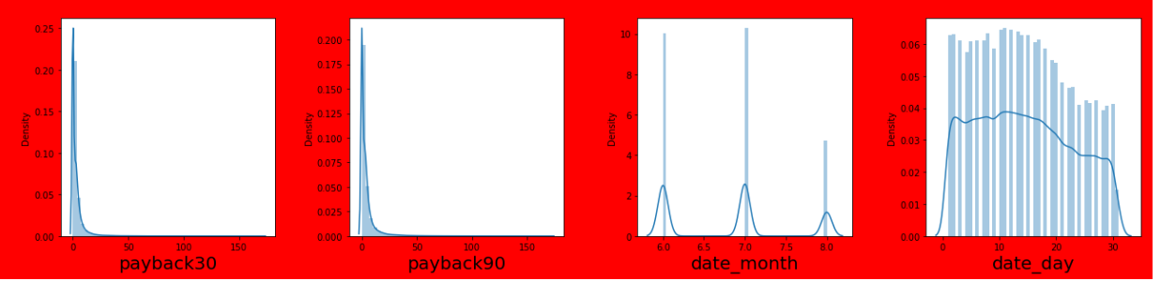
Observations from the distplots
From the above distribution plot, I can observe most of the columns are not normally distributed only Day column somewhat distributed normally.
All the columns have skewness and are skewed to right since the mean is greater than the median in these columns. We need to remove this skewness before building our machine learning models.
Now let’s find out the outliers using boxplots.

Slide 20
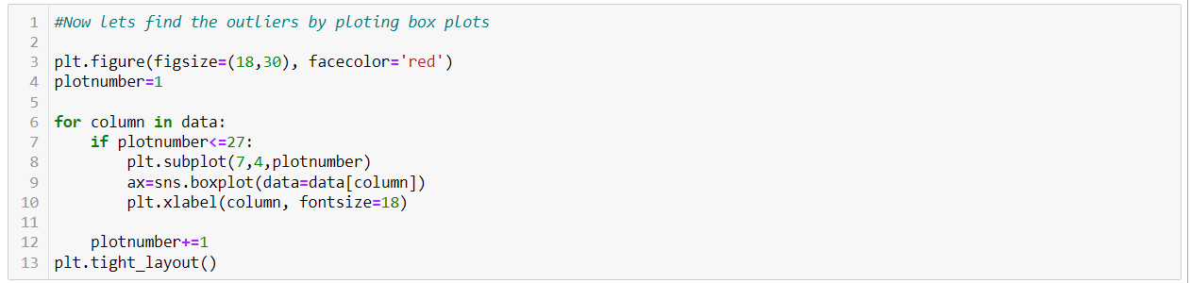
Checking for outliers using Box plots

Slide 21
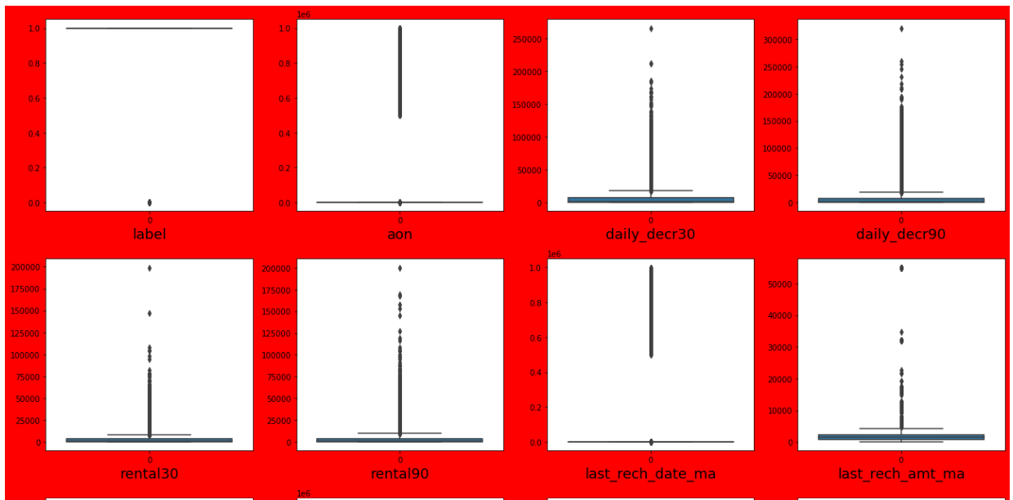

Slide 22
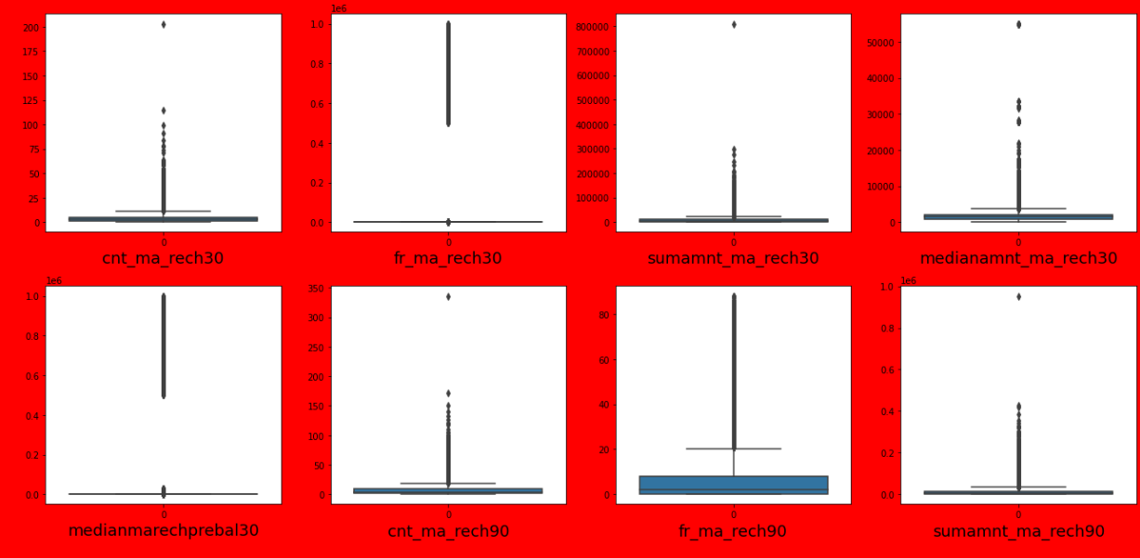

Slide 23
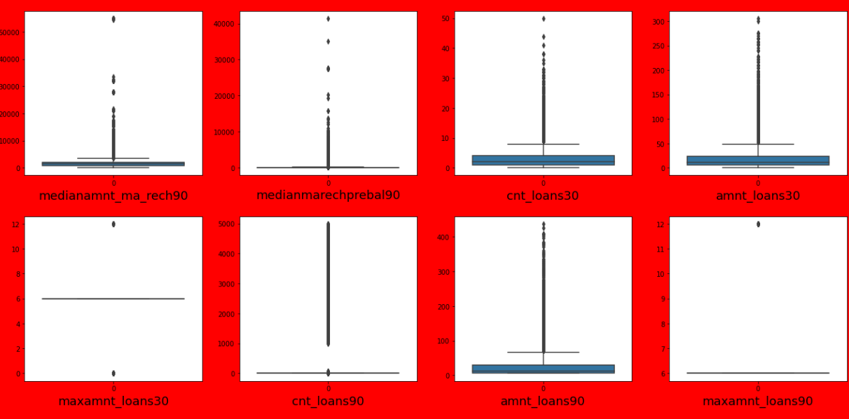

Slide 24
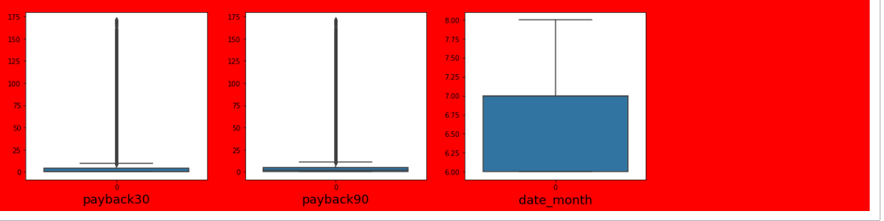
Observations from the Box Plots
From the above box plot we can notice the outliers present in all the features except Day and Month columns. Let's remove the outliers in these columns except Day and Month.
We have removed the outliers by using different methods.

Slide 25
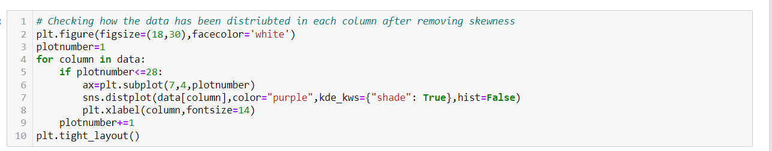
Checking the distribution of all the features after removing the skewness

Slide 26
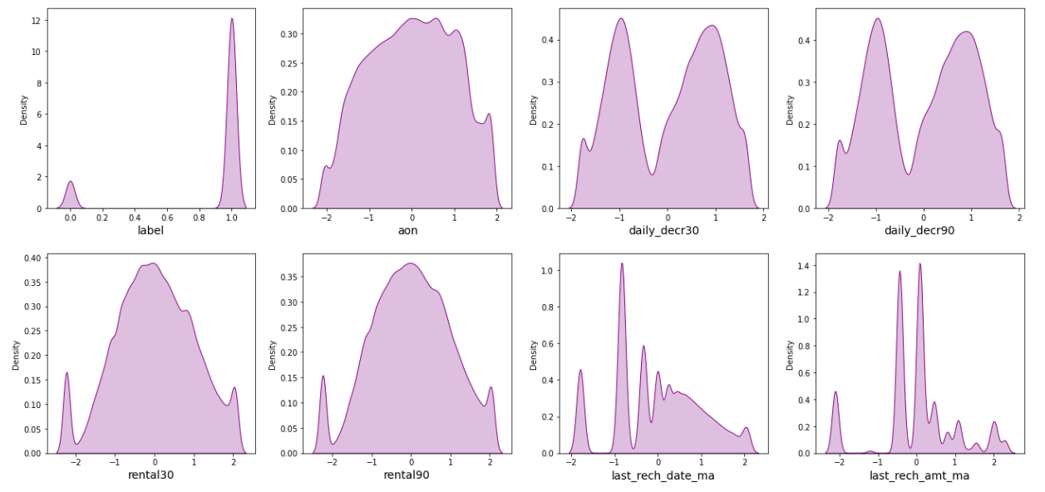

Slide 27
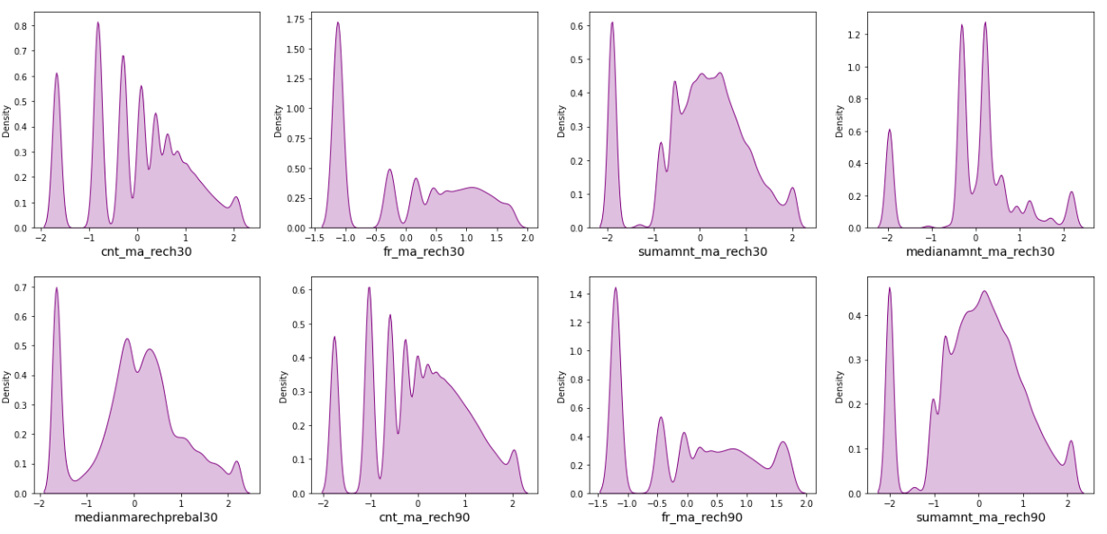

Slide 28
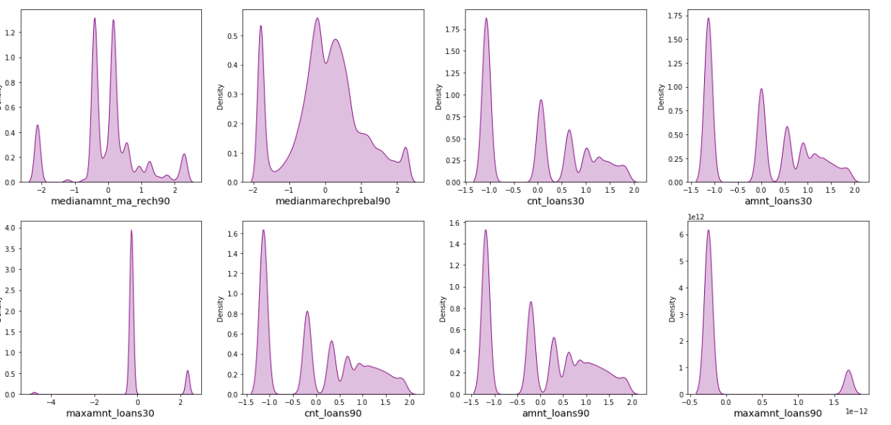
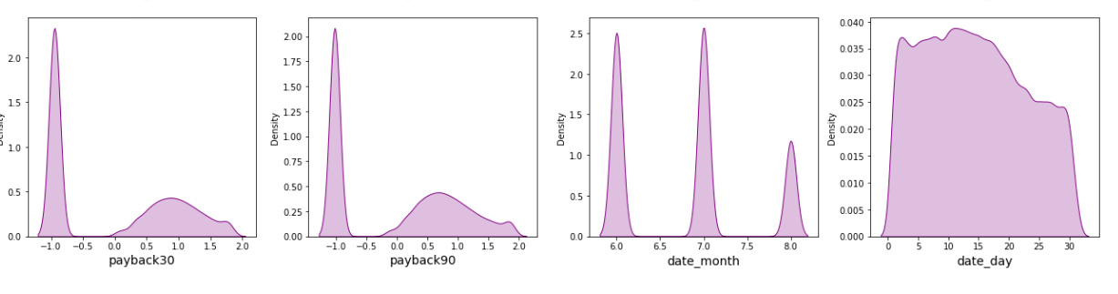

Slide 29
After removing the skewness we can observe that the distribution looks much better as compared to before.
From the above dist plots we can see that the data has been distributes normally in some of the columns and the skewness is also reduced compared to the previous data.

Slide 30
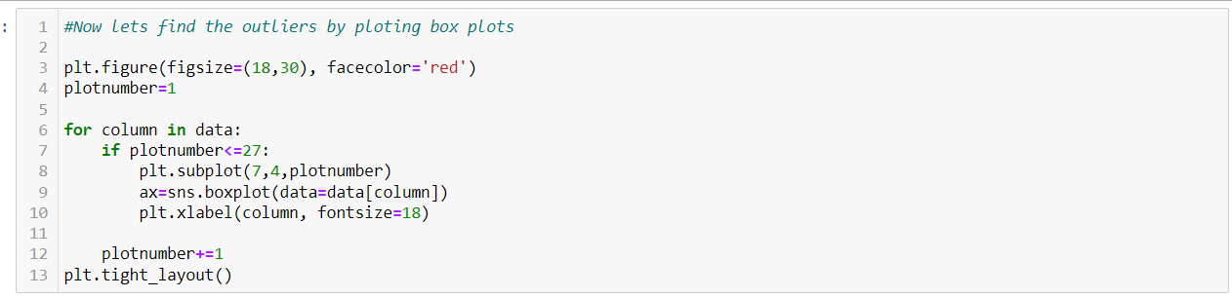
Checking whether the outliers are removed after using IQR and Percentage method

Slide 31
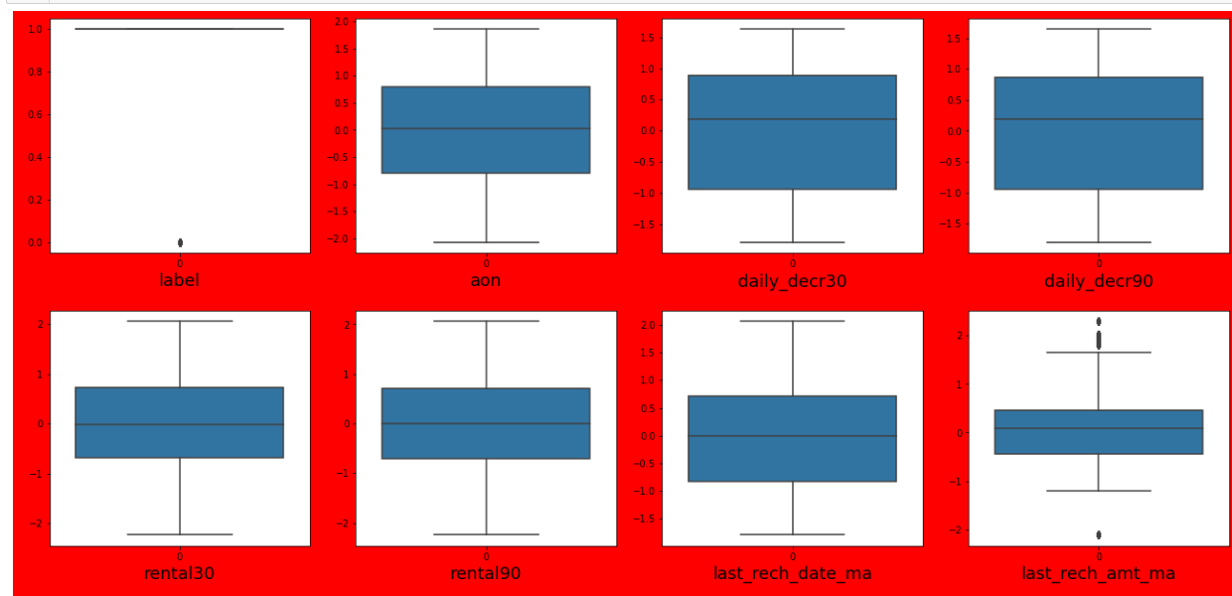

Slide 32
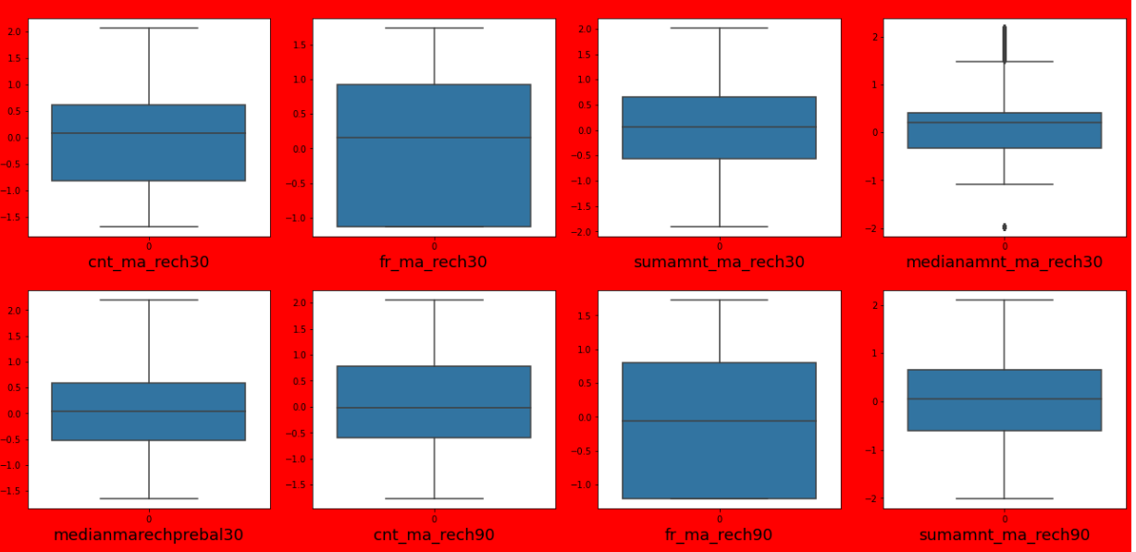

Slide 33
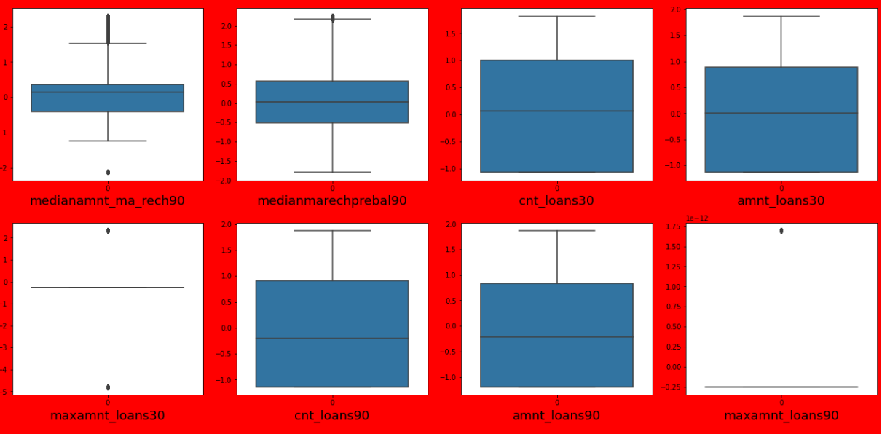

Slide 34
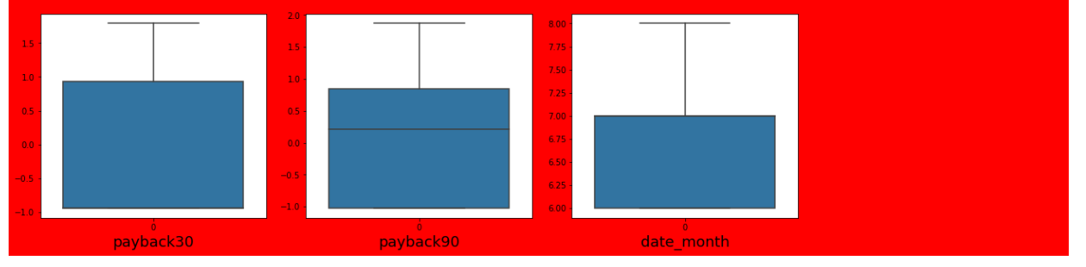
It’s good to see that the outliers are almost removed in many columns after using percentile method and after removing skewness.
After cleaning the data we got only numerical data throughout the dataset. Since all the features in the dataset are numerical so no need to encode the data.

Slide 35
Plotting heatmap to find out the relation among the features and relation between the features and labels.

Slide 36
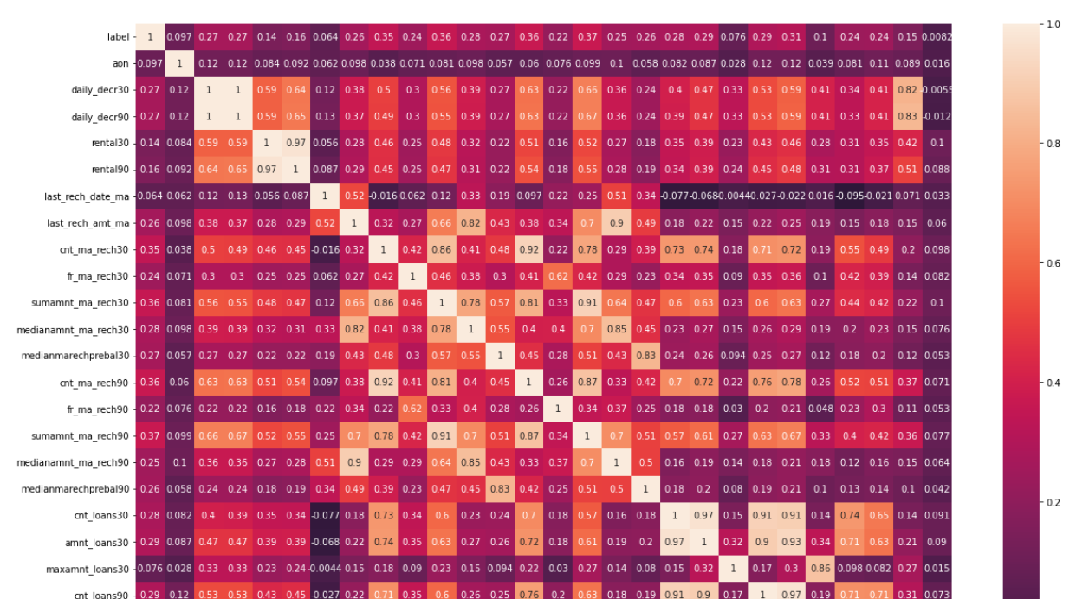

Slide 37
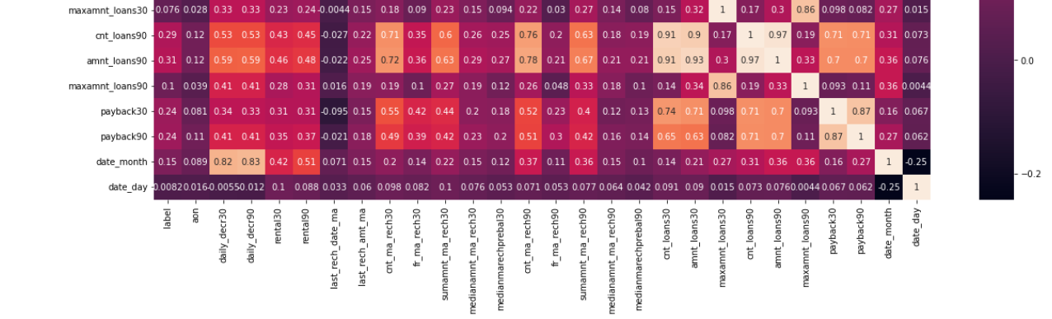

Slide 38
Observations from the heatmap:
This heatmap shows the correlation matrix of the data. We can observe the relation between one feature to other and relation between features and label. Here we can notice there is no strong relation between features and label.
Dark shades are highly positively correlated with the label and light shades are highly negatively correlated with the label.

Slide 39
The features having high correlation
sumamnt_ma_rech30
daily_decr30
daily_decr30cnt_ma_rech30
cnt_ma_rech90cnt_loans30 & cnt_loans90
amnt_loans30 & amnt_loans90

Slide 40
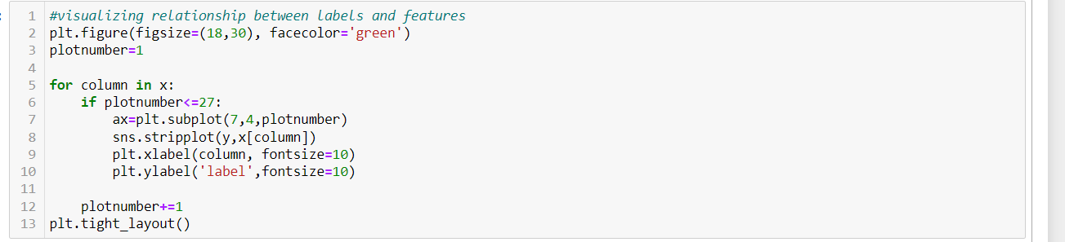
After that I have used strip plot to find out the relationship between the features and label.

Slide 41
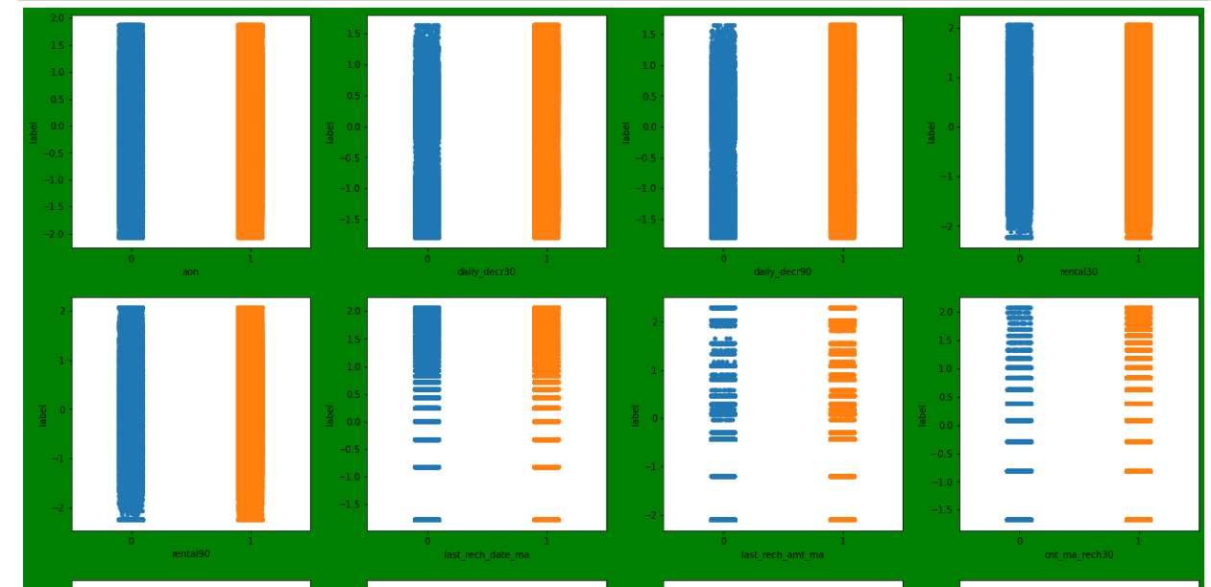

Slide 42
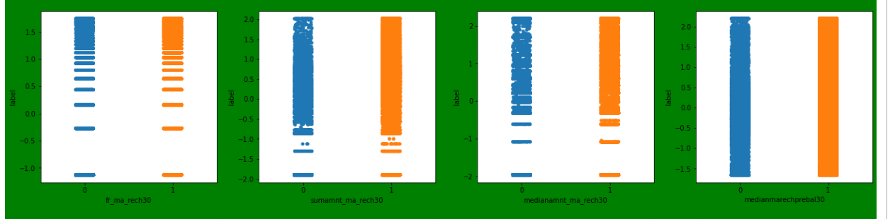

Slide 43
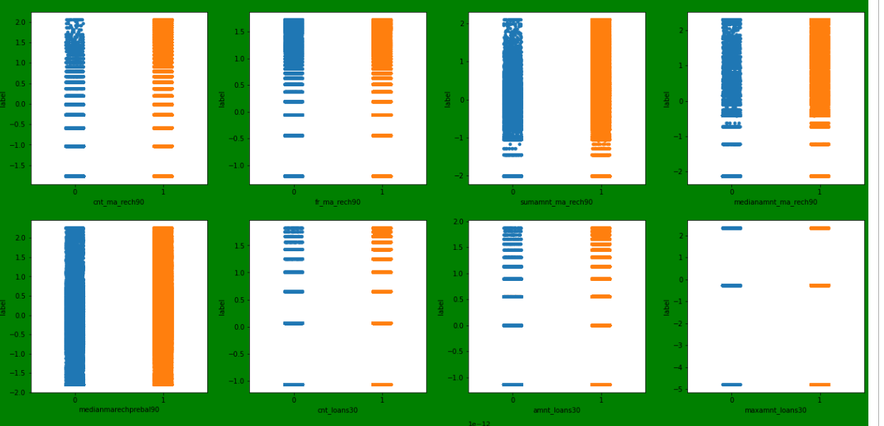

Slide 44
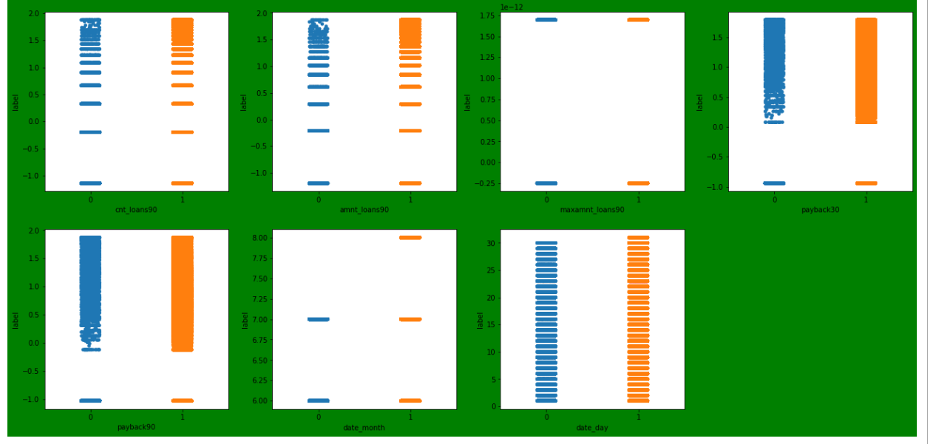
All the features show positive correlation with the label. Let’s also use bar plots to know about the type of relationship between the features and the label.

Slide 45
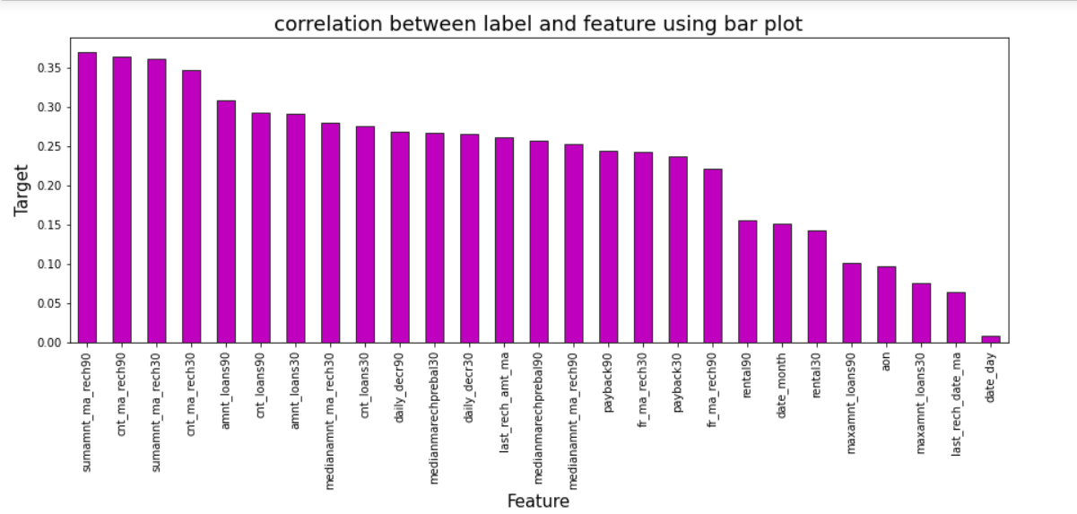
From the bar plot we can clearly observe the positive correlation between the label and features.

Slide 46
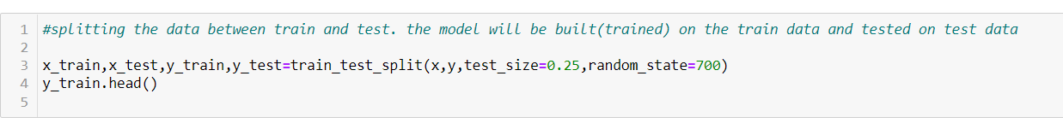
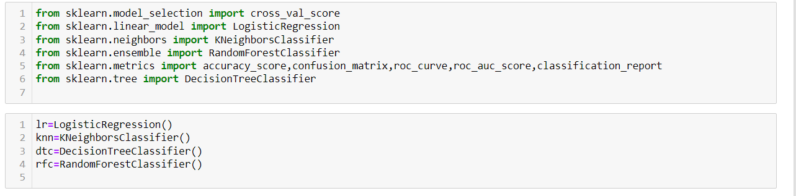
In this study I have used 4 classification algorithms and chosen the best model among them by accuracy score, Cross Validation scores and AUC value.

Slide 47
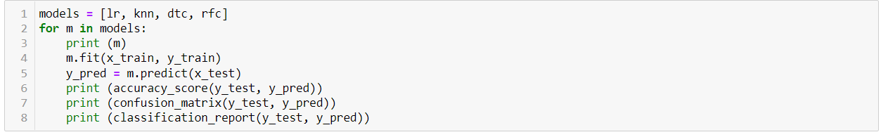

Slide 48
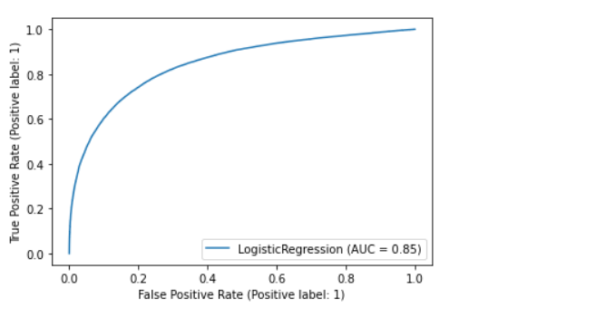
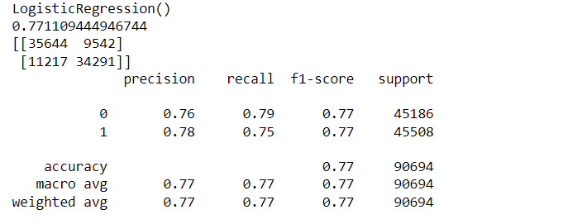
LogisticRegression Model

Slide 49
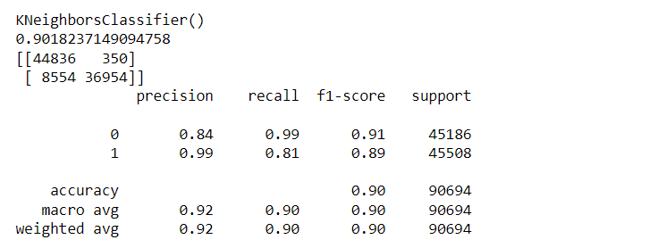
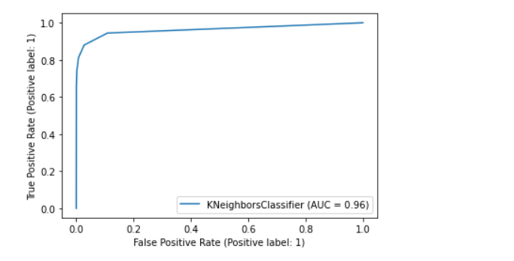
KNeighbors Classifier Model

Slide 50
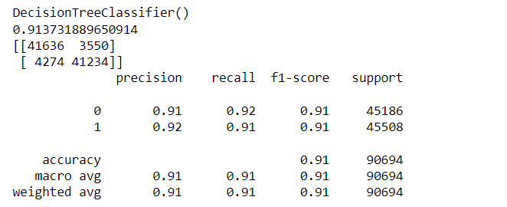
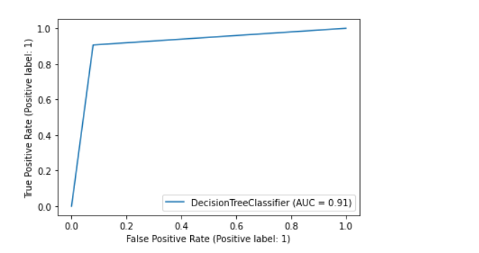
DecisionTree Classifier Model

Slide 51
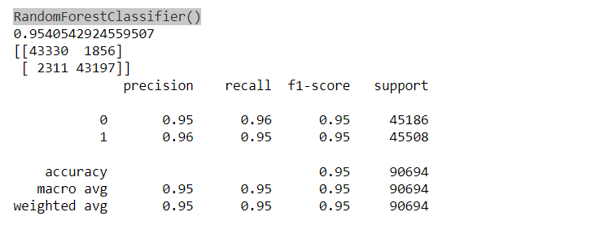
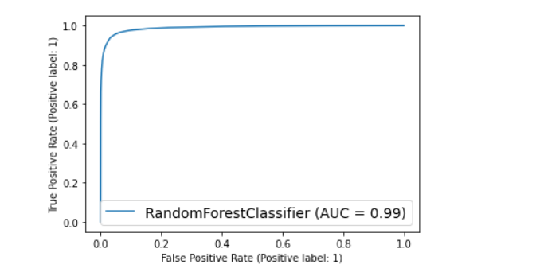
RandomForest Classifier Model

Slide 52
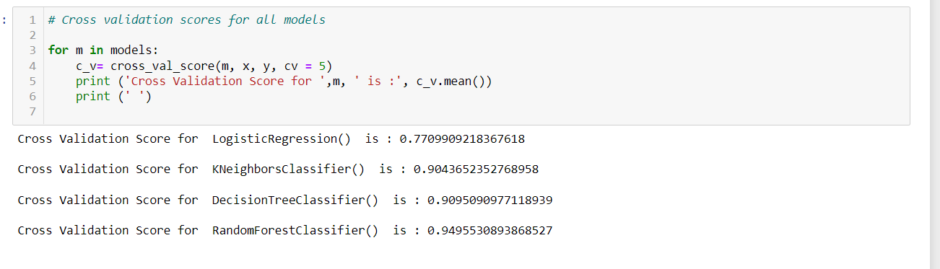
Cross Validation scores for all the models
We have concluded that the RandomForestClassifier() model is the best model based on the accuracy, Cross validation and AUC scores among all the models. So now let’s use RandomForestClassifier() for further analysis and lets check whether we can improve the accuracy of the model by using Hyperparameter tuning using GridSearchCV.

Slide 53
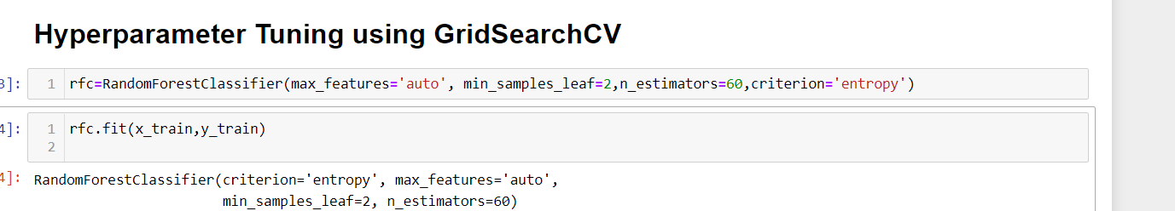
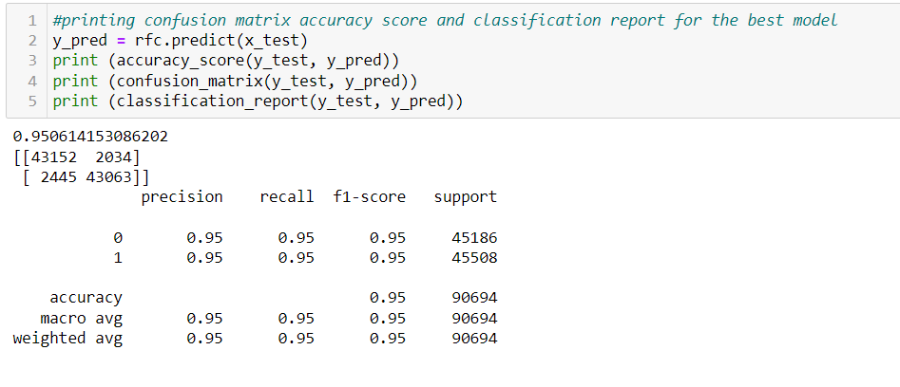
Hyperparameter tuning using GridSearchCV

Slide 54
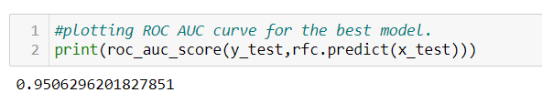
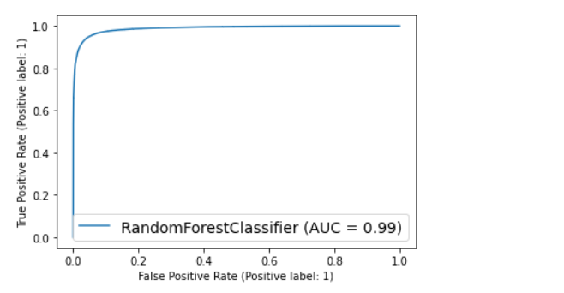
The accuracy score has also increased after using hyperparameter tuning using GridSearchCV

Slide 55
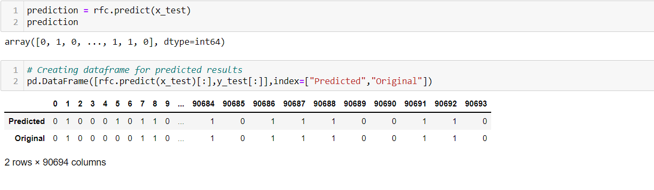
Predicting label using our best model.
Using classification model, we have got the predicted values for micro credit loans for defaulters and non-defaulters. From the predictions we can notice both actual values and predicted values are almost same.

Slide 56
Saving the model

Slide 57
Conclusions
This case study aims to give an idea of applying EDA in a real business scenario. In this case study, apart from applying the techniques that we have learnt in the EDA module, we will also develop a basic understanding of risk analytics in banking and financial services and understand how data is used to minimise the risk of losing money while lending to customers. From this dataset we were able to understand that the selection of customers for the credit to know whether they are defaulters or non-defaulters are done on the basis of different features.
In this study, we have used multiple machine learning models to predict the micro credit defaulters’ rate. We have gone through the data analysis by performing feature engineering, finding the relation between features and label through visualizations. And got the important feature and we used these features to predict the defaulters’ rate by building ML models. After training the model we checked CV score to overcome with the overfitting issue. Performed hyper parameter tuning, on the best model and the best model accuracy increased by 1% and the accuracy score was 95%. We have also got good prediction results.

Slide 58
Findings: From the whole study we found that the MFIs have provided loan to the user who have no recharge or balance in their account which needs to be stopped. Also, the frequency of main account recharged in last 30 days & 90 days we have seen the users with low frequency are causing huge losses, company should implement some kind of strategies to reduce like sending SMS alerts for notification. We found the defaulting rate is higher in old customers list. We found outliers and removed them and couldn’t remove all the outliers since the data is expensive so, proceeded the data with remaining outliers. Further, removed skewness. Looking at the heat map, I could see there were few features which were correlated with each other, yet I haven’t removed them based on their correlation thinking multicollinearity will not affect prediction. Other insight from this study is the impact of SMOTE on the model performance as well as how the number of variables included in the models.

